Slide 1
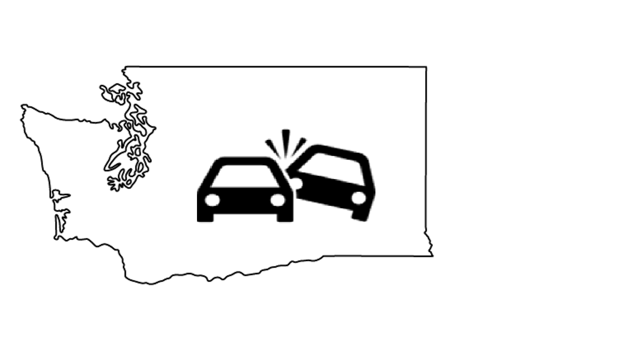
Washington Collisions
A deep dive on collisions in Seattle
By: Libby Montague, Fei Wang, Geoff Coyner, Salik Warsi
Notes:
LIbby

Slide 2
Background
Motivations
Visualize relationship between weather, Seattle neighborhoods and collisions.
Develop tools to investigate research questions with this data.
Did a 2016 change in central Seattle speed limits reduce the number of collisions or collision related injuries?
Audience
Seattle policy makers
Urban planners
Research questions
Neighborhood groups
How do collisions vary by neighborhood and time?
Is there a relationship between weather and collisions?

Slide 3
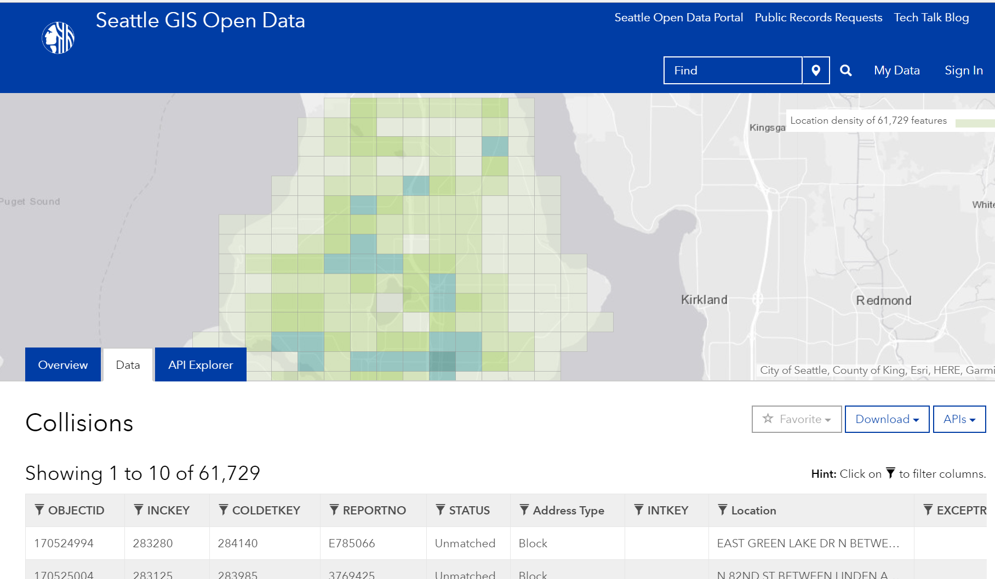
Seattle Collision Data
Downloaded from Seattle GIS open data portal
Provides 48 attributes for Seattle collisions since 2004
Majority of collisions include exact geo-coordinates.
Includes a weather attribute but it’s sparsely populated and qualitative.
Notes:
Data available at this portal here: https://data-seattlecitygis.opendata.arcgis.com/datasets/collisions?geometry=-122.579%2C47.656%2C-122.001%2C47.737

Slide 4
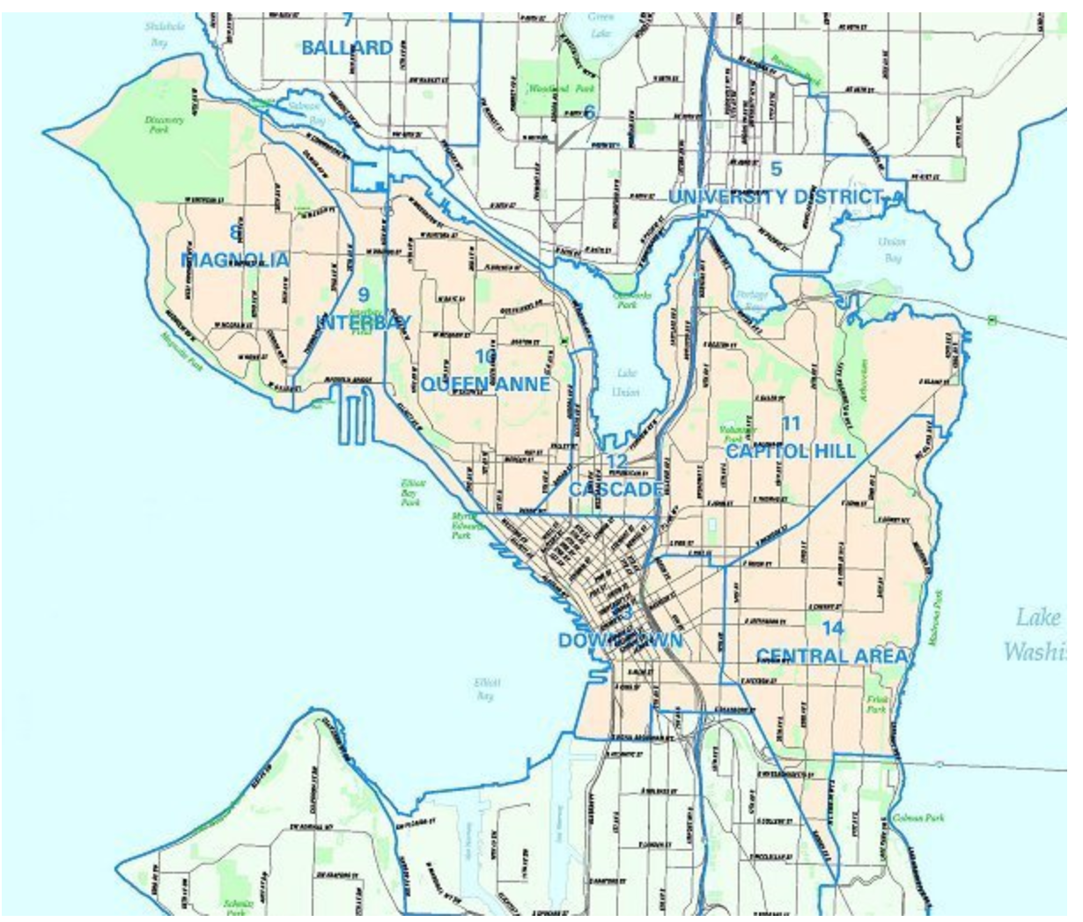
Seattle Neighborhoods Data
Shape File of the boundaries of neighborhoods used by the City Clerks Office
Used to understand collisions at a level useful to neighborhood groups
Helpful in analyzing policy questions that impacted some neighborhoods, like changing speed limits.
Notes:
Data available here: https://data.seattle.gov/dataset/Neighborhoods/2mbt-aqqx
Image from: http://clerk.seattle.gov/~public/nmaps/central.htm

Slide 5
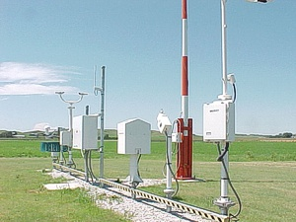
Weather Data
Downloaded from Iowa State University database of hourly airport AWOS/ASOS reports.
Combined data from SeaTac, Renton, Boeing Field used as source for hourly weather information.
Notes:
Data available at this portal here: https://mesonet.agron.iastate.edu/request/download.phtml
Photo from: https://www.weather.gov/asos/

Slide 6
Use Cases
Clean and prepare Seattle area collision data for regression and other machine learning projects.
Create visualizations of Seattle area collision data.
Casual Impact analysis of Seattle area collision data and the change in speed limits.
Notes:
LIbby

Slide 7
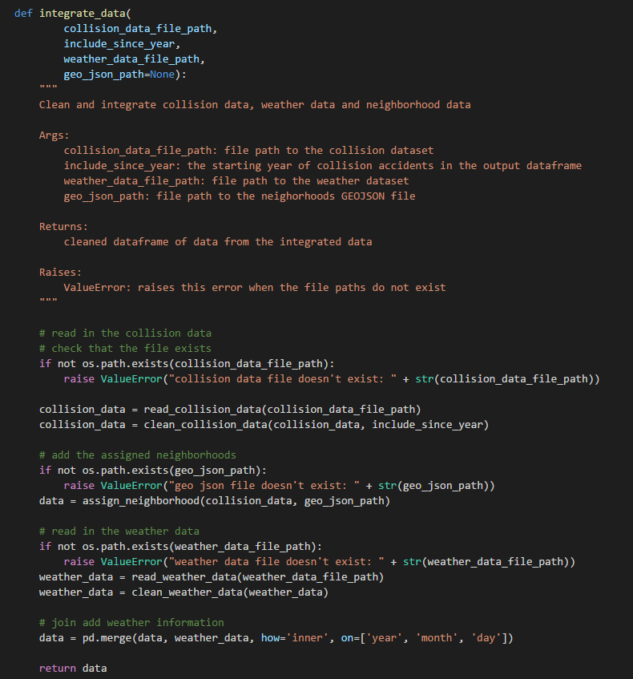
Demo: Prepare Data
Creates a cleaned and integrated dataset.
Example Jupyter notebook walks the user through downloading the necessary data.
Small subsets of data are on the repo and used for testing.

Slide 8
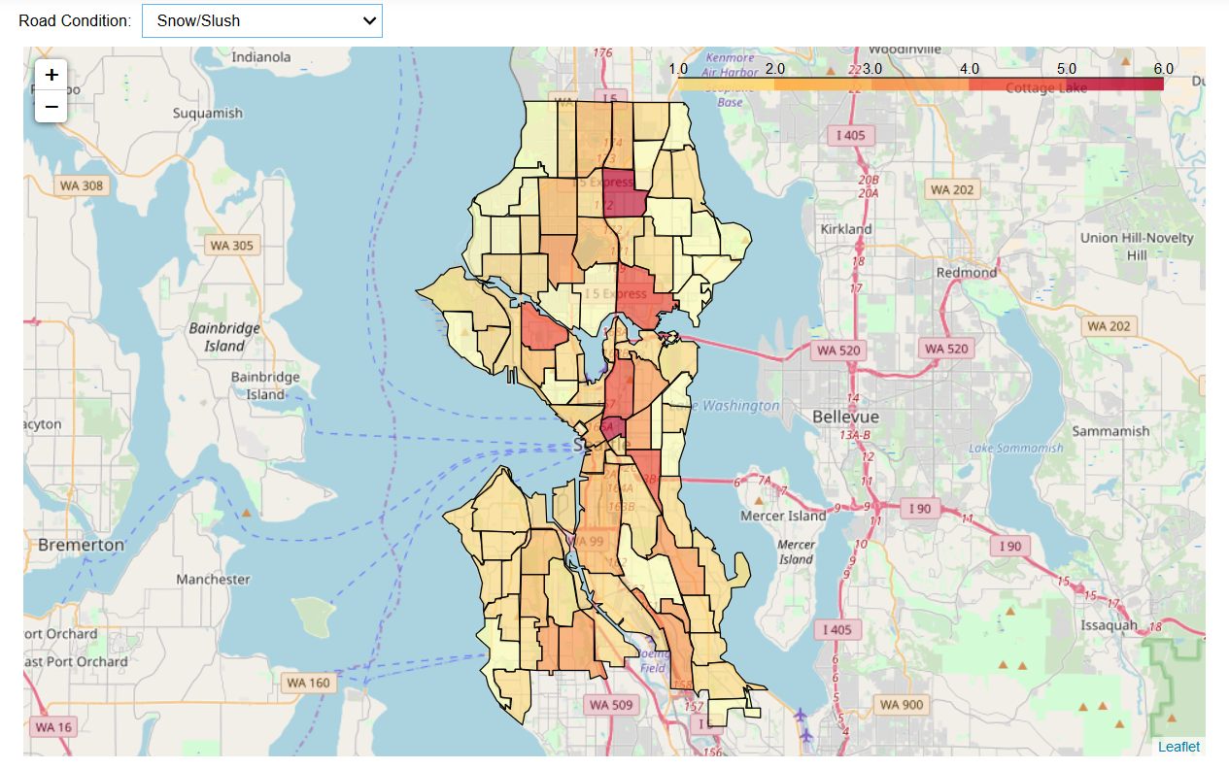
Demo: Visualize Neighborhoods
Assigns a neighborhood to each collision based on shape file.
Visualize data per neighborhood.
Use interactive drop down to analyze data.

Slide 9
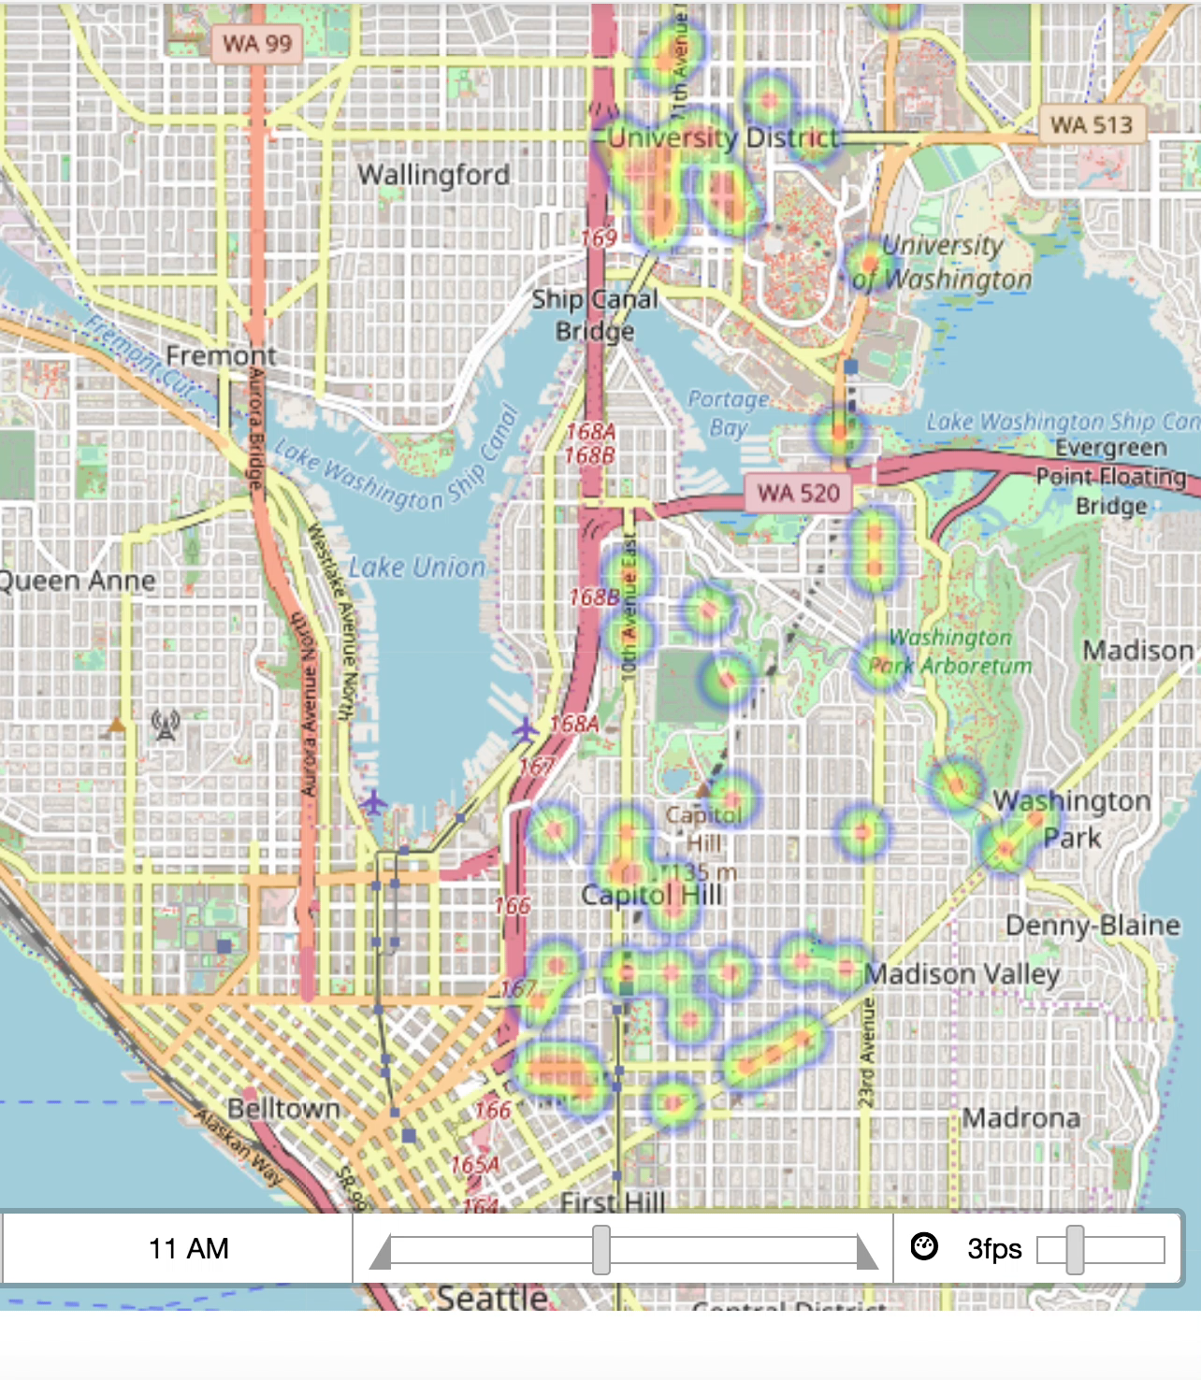
Demo: Visualize Collision density over time
Aggregates collisions by hour.
Allows user to input neighborhoods and time frame of interest for comparison.
Presents collision heatmaps over time to compare the neighborhoods.

Slide 10
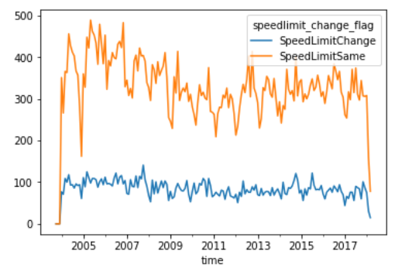
Demo: Casual Impact
Monthly volume of collision related injuries (neighborhoods with speed limit change vs. others)
Groups neighborhoods into those where speed limits changed in 2016 and those where they did not.
Uses Bayesian structural time series model to compare collisions and injuries in counter-factual “control” vs. “treatment” groups.
Notes:
Demo notebook: https://github.com/gdc3000/wa_collisions/blob/master/examples/Example%20-%20CausalImpact%20SpeedLimits.ipynb

Slide 11
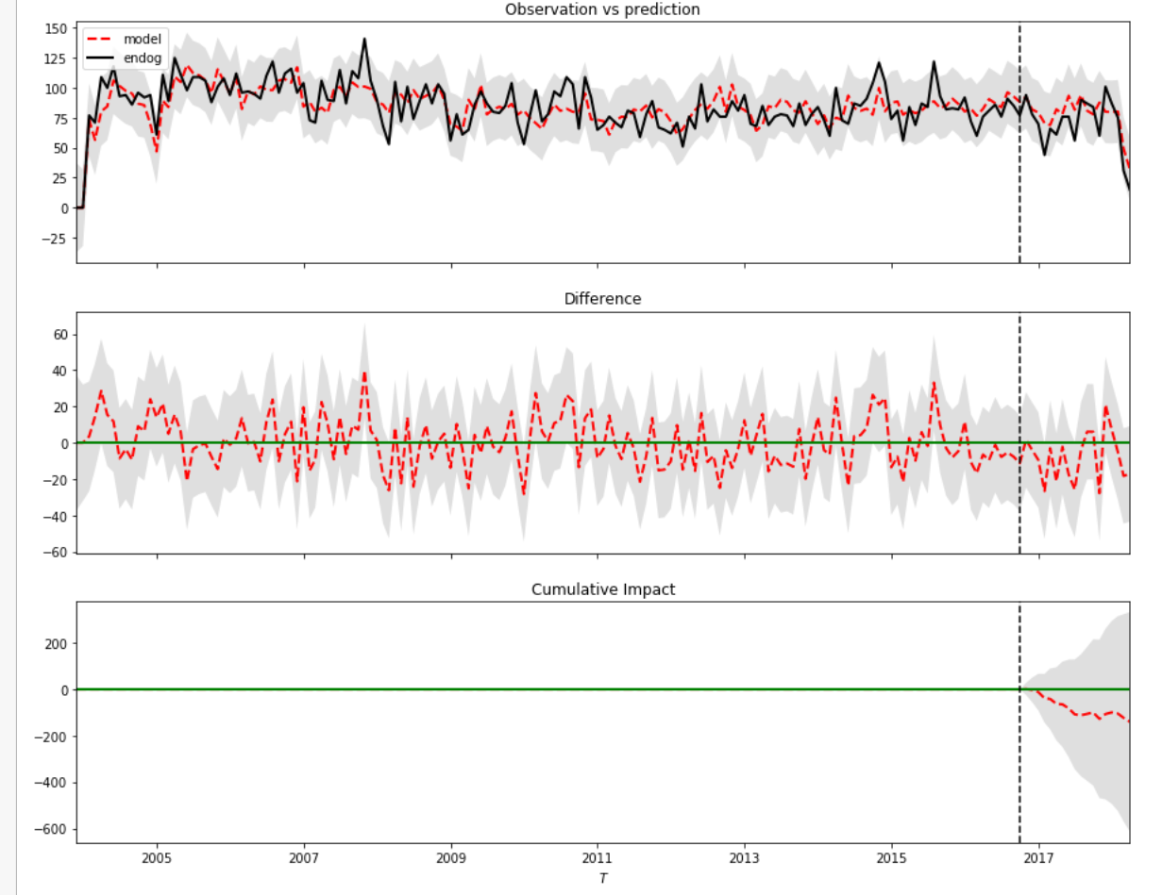
Demo: Casual Impact
Results of Causal Impact Study: volume of collision injuries in neighborhoods with speed limit change
Groups neighborhoods into those where speed limits changed in 2016 and those where they did not.
Uses Bayesian structural time series model to compare collisions and injuries in counter-factual “control” vs. “treatment” groups.
We find fewer injuries (but not stat sig) after the speed limit change.
Notes:
Monthly # of collision related injuries across Seatle neighborhoods

Slide 12
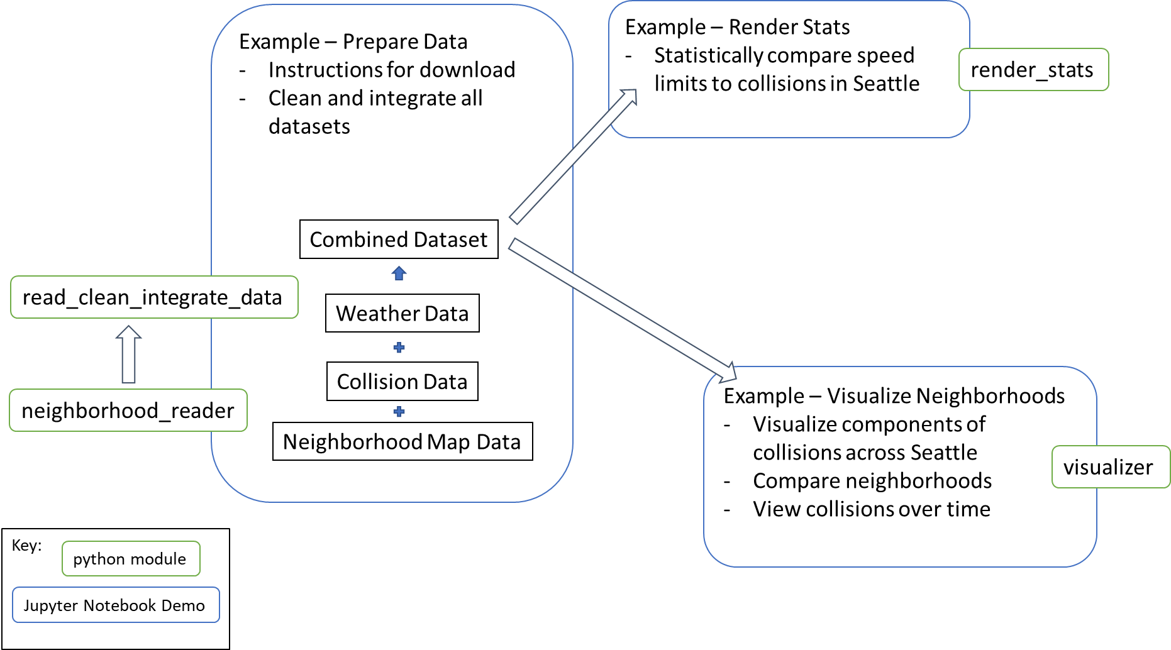
Design
One module used to curate data for models and visualizations (read_clean_integrate_data).
Separate modules built on top of read_clean_integrate_data to analyze speed limits and visualize the data.

Slide 13
Project Structure
wa_collisions/
|- README.md
|- wa_collisions/
|- __init__.py
|- neighborhood_reader.py
|- read_clean_integrate_data.py
|- render_stats.py
|- visualizer.py
|- data/
|- …
|- tests/
|- __init__.py
|- test_neighborhood_reader.py
|- test_read_clean_integrate.py
|- test_render_stats.py
|- test_visualizer.py
|- examples/
|- Example - CausalImpact SpeedLimits.ipynb
|- Example - Prepare Data.ipynb
|- Example - Visualize Data.ipynb
|- doc/
|- Feature_Design_V1.md
|- Feature_Design_V2.md
|- …
|- .coverage
|- .coveragerc
|- .gitignore
|- .pylintrc
|- .travis.yml
|- LICENSE
|- requirements.txt
|- setup.py
Modeled after the Shablona template.
One example Jupyter notebook for each use case.
Four modules that are each used in at least one use case.
Test scripts for each of the modules.

Slide 14
Lessons Learned
Object-oriented design
Code re-use can create collaboration challenges but ultimately pays off. Putting more code in modules ensures it can be used in multiple use cases.
Compatibility
Always run your code on multiple systems. We discovered a known issue with folium (only works with Firefox)
Continuous integration
Travis CI was a great tool to prevent regressions and ensure our test coverage was high.

Slide 15
Future Work
Add data from the rest of Washington State or more cities to enrich analysis of speed limits and visualizations.
Visualize the change of collision density among different neighborhoods over time (leverage Folium’s time_slider_choropleth plugin: still being developed (https://github.com/python-visualization/folium/issues/831)

